Slide 1
SCATTERPLOTS

Slide 2
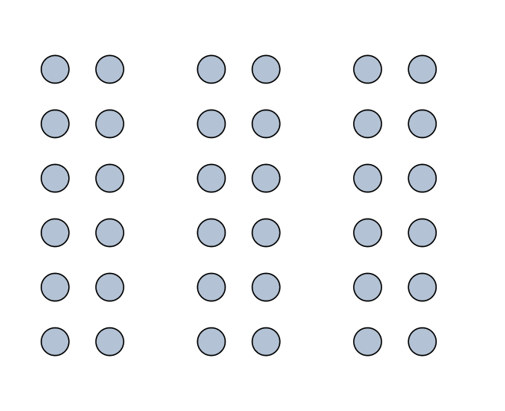
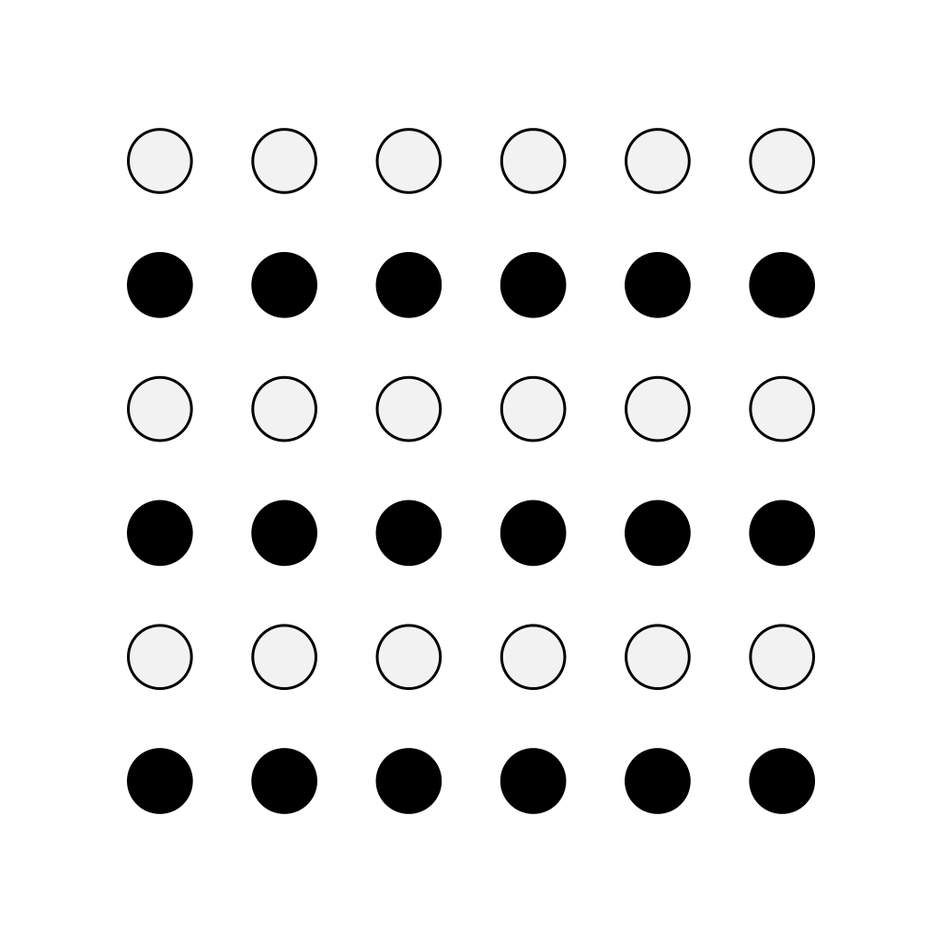





SCMA Visit #1: debrief
proximity
similarity
[ ]
symmetry
closure
common fate
continuity

Slide 3
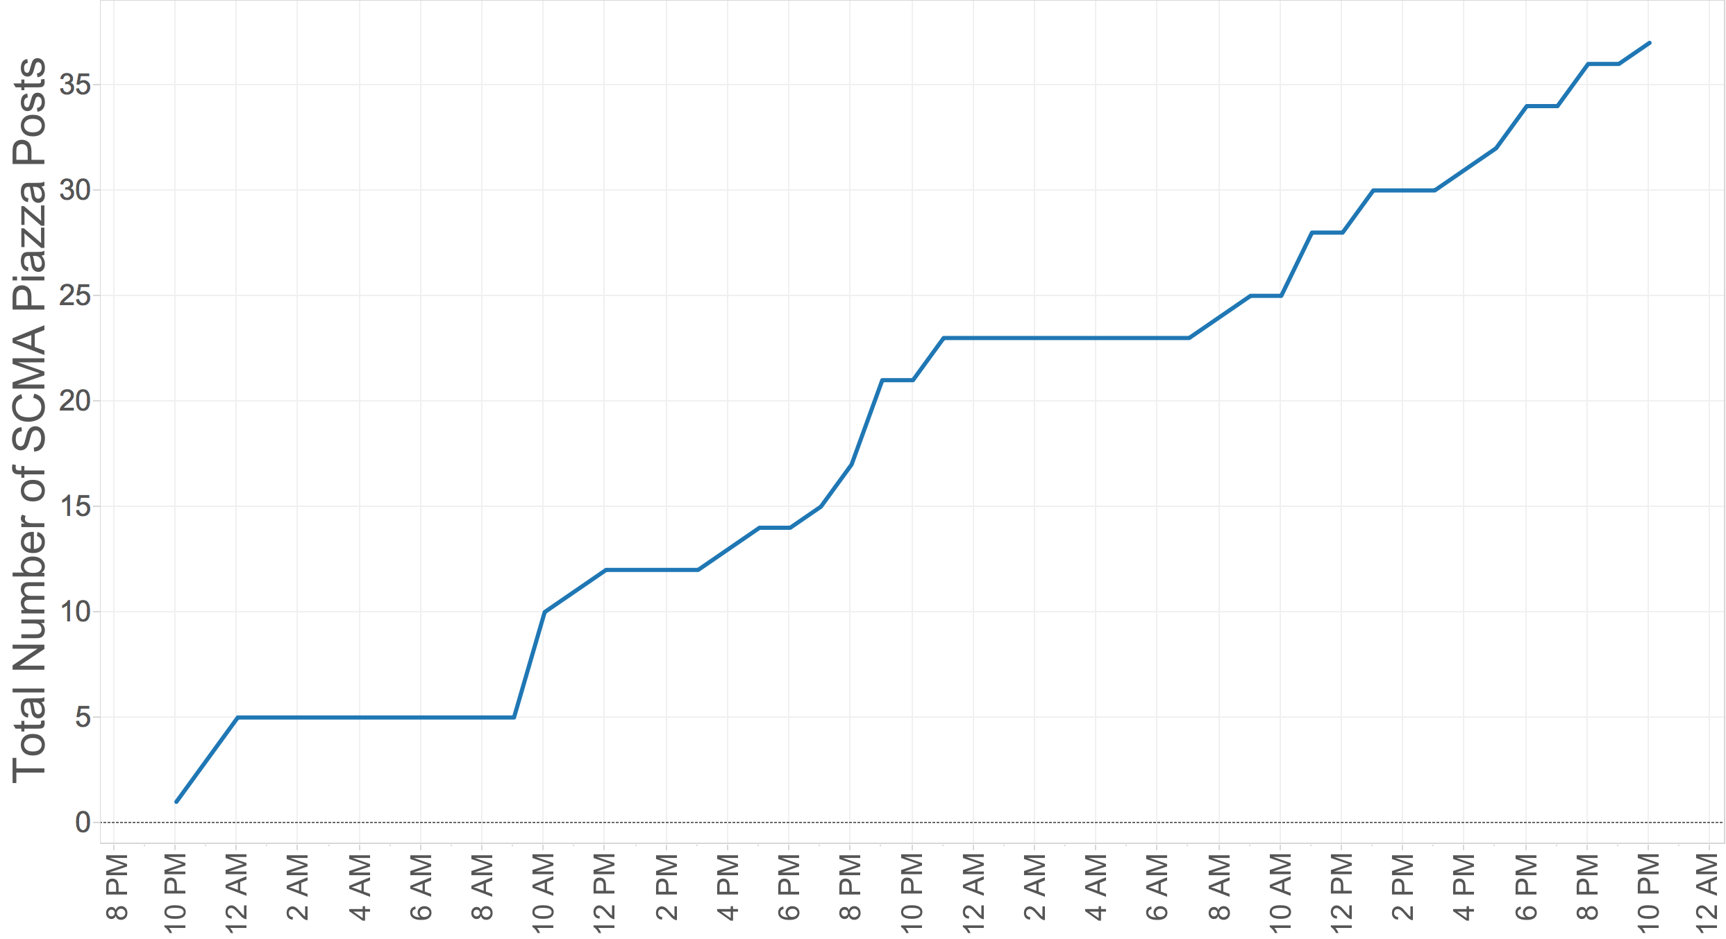
SCMA Visit #1: some more data
Tuesday Sept. 27
Wednesday Sept. 28

Slide 4
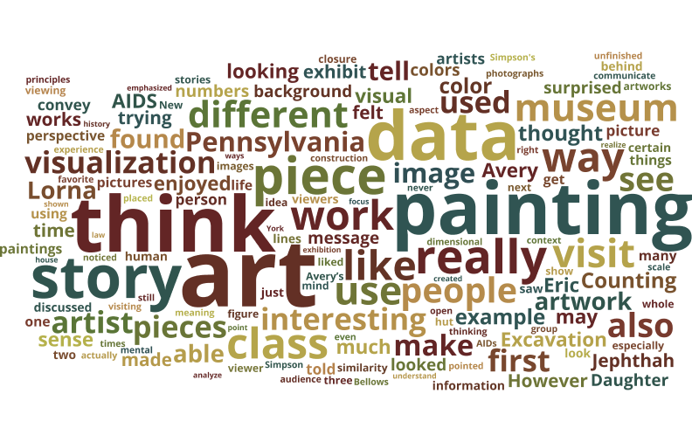
SCMA Visit #1: even MORE data

Slide 5
Outline
Scatterplots
Definitions
Comparing multiple categories
What gets encoded?

Slide 6
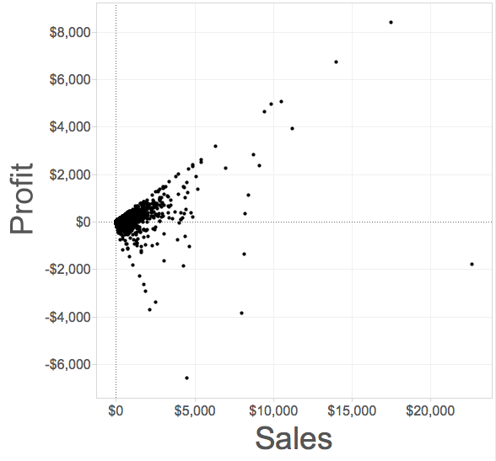
Scatterplot
Definition: a visualization that shows the correlation between two quantitative (numerical) variables
Each point represents an observation
One axis shows one quantitative measure
The other axis shows a second quantitative measure

Slide 7
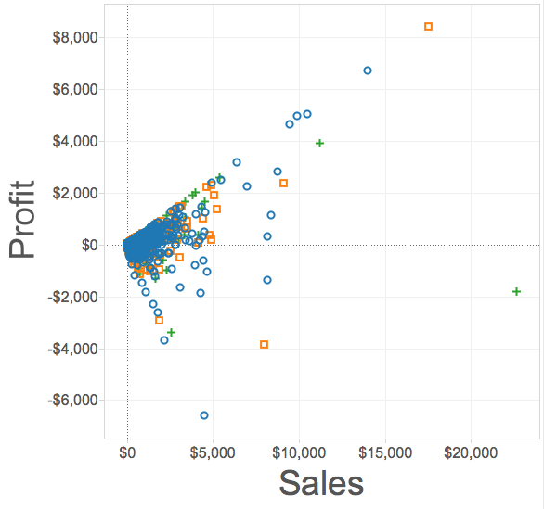
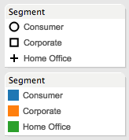
Scatterplots on multiple categories
We can change the mark type to compare the same variables across different categories

Slide 8
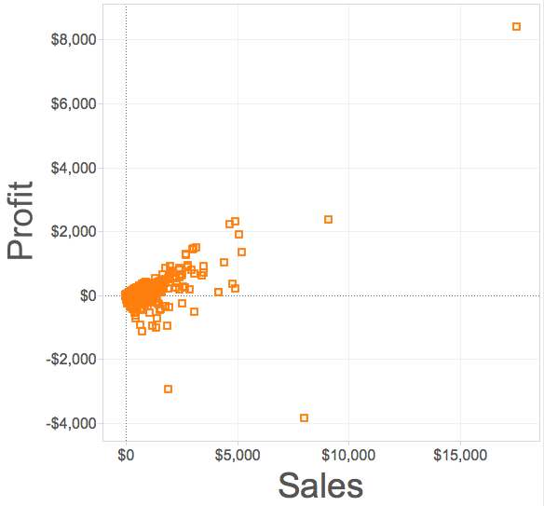
Correlation
Scatterplots are particularly useful for highlighting correlation (what’s that?)
(whether the variables tend to change together)
Trend line (a.k.a “line of best fit”)

Slide 9
Trend lines
May pass through all, some, or none of the data points
Useful for making predictions
Trend line (a.k.a “line of best fit”)

Slide 10
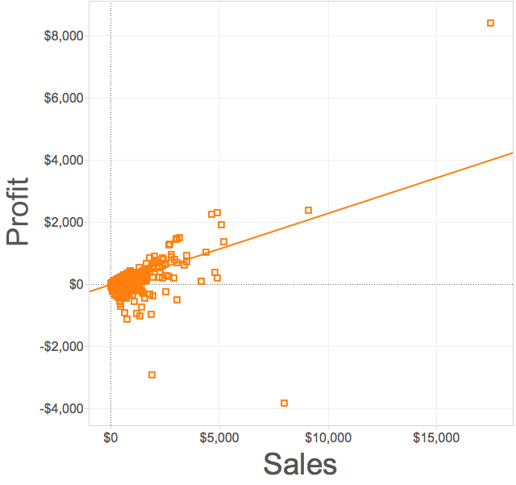
Positive correlation
Two variables moving in the same direction
Trend line points up and to the right

Slide 11


Positive correlation: example

Slide 12
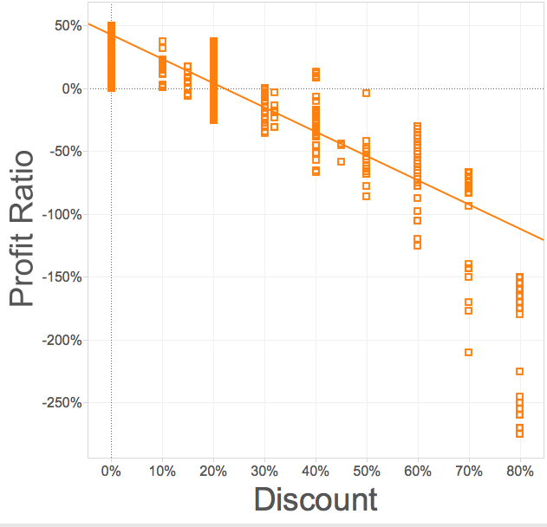
Negative correlation
Two variables moving in opposite directions
Trend line points down and to the right

Slide 13

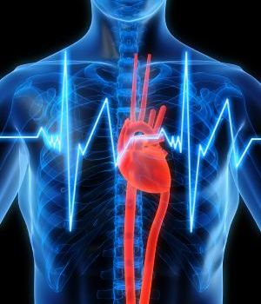
Negative correlation: example

Slide 14
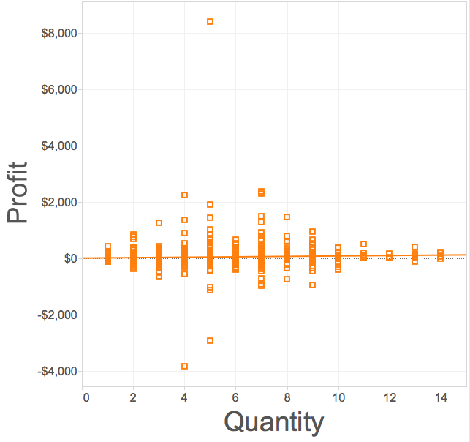
No correlation
Two variables are independent of one another
No discernable pattern
Trend line is flat

Slide 15
No correlation: example

Slide 16
What gets encoded
Maximum value(s) in each dimension
General trend
(what law is at work here?)
Outliers (points that are “far from the pack”)
Minimum value(s) in each dimension

Slide 17

Pros and cons
What’s good about scatterplots?
What’s not so good?

Slide 18
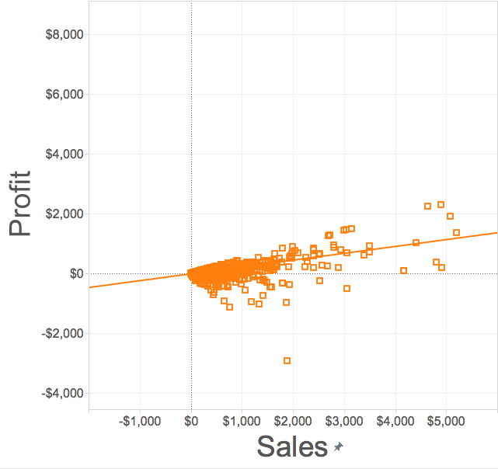
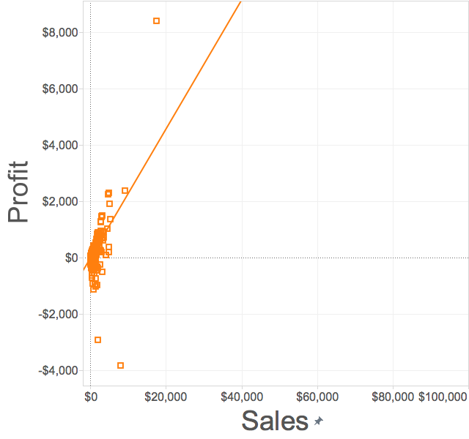
Things to watch out for
Choice of scale matters

Slide 19
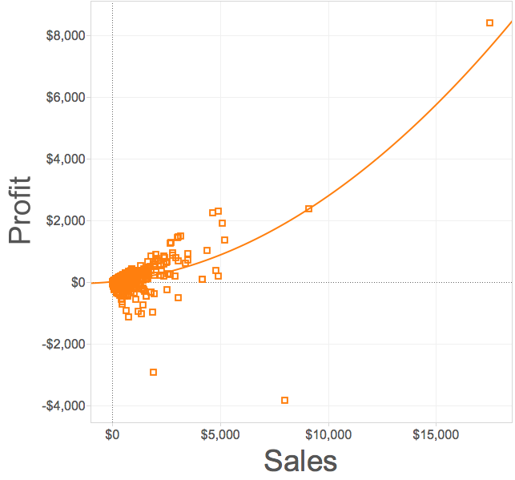
Things to watch out for
Linear
Quadratic
Choice of model matters

Slide 20
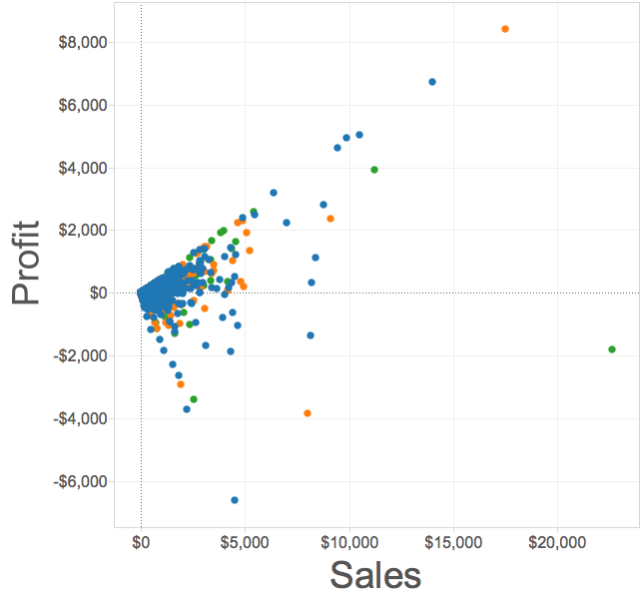
Things to watch out for
Overplotting can make it hard to tell
what’s going on in different categories

Slide 21
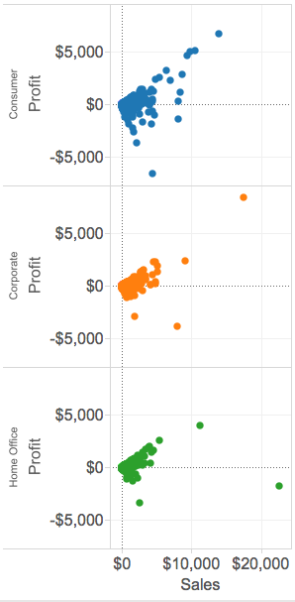
Things to watch out for
When this is the case, using
small multiples can sometimes help

Slide 22
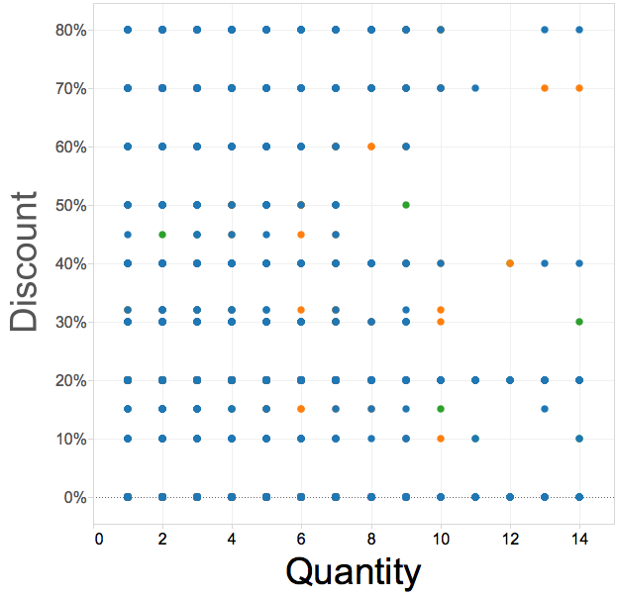
Things to watch out for
Variables with only a few unique values can also pose a problem

